Slide 1
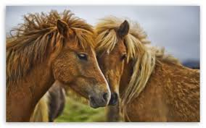
The horse's maintenance requirements

Slide 2
To help clients calculate feed rations for young horses, sport horses and all other types of horses, it is necessary for them to understand what the horse requires of energy and nutrients "just to survive from day to day.“- maintenance needs!
So you have confidence in the programme,
this handout provides background on:
- How maintenance requirements are calculated - A demo: How to use PC-Horse to create a ration - Practice: Create rations to your own horse as a "maintenance horse»

Slide 3
Background info on:
the term "maintenance“
Calculation of the maintenance requirement for energy and protein in horses of different type and gender.
feed rations for horses at maintenance
the use of different qualities of forage for horses at maintenance
Supplementation of a roughage-based ration with concentrates or mineral and vitamin supplements to cover the horse's nutritional needs

Slide 4
Units for energy and protein
In the UK and Ireland the unit for energy is Megajoules (MJ) of digestible energy. Other countries use Megacalories (MCal) or Feed Units for horses. 1MCal = 4.185MJ In the UK and Ireland, “Crude protein” is the unit for protein. In other countries “Digestible crude protein” is used.

Slide 5
What does “maintenance requirement” mean?
With maintenance requirement we mean the nutritional needs of an adult horse that does not perform any kind of work or training, and are neither pregnant nor producing milk.
The maintenance requirement is calculated from the horse's body weight, breed / type and gender. Use a weightape to obtain the horse’s bodyweight
Breed / type. Certain types of horse, ponies and cold-bloods, have a calmer disposition and therefore need somewhat less energy than the more noble horses. Remember that there may be significant variations between horses within a particular breed.
Sex. Stallions have a higher maintenance requirements for energy and protein than mares and geldings (Usually 10% higher requirement).
Nutritional requirements based on NRC Recommendations for horses (2007).

Slide 6
The maintenance energy requirement
The energy requirement is given as Megajoules of Digestible energy, and must be covered by the feeds included in the ration
Most grain and feed mixtures has an energy content of 10-12 MJ per kg of feed.
Hay, haylage, grass and straw are roughage feeds with less digestible energy per kg.
When we compare the energy content of roughages it is important to compare on a per kg dry matter basis (i.e. per kg of dry feed). This is because the water content of haylage and grass can vary widely.
Typical energy content of forages (excluding straw) will be 7 to 10 MJ per kg dry matter, variation, however, is large.
If you have a roughage analysis from a laboratory, you should observe that energy content is usually given both for the feed sample, and on a dry matter content basis. The two numbers may be very different!

Slide 7
How is the energy requirement calculated?
Maintenance energy requirements for mares and geldings are calculated as:
14 MJ Digestible energy per 100 kg body weight to warm-blooded horses.
Thoroughbreds will get a 10% increase in the estimated maintenance requirements to 15.2 and ponies and cold-blooded a reduction of 10% to 12.7 MJ per 100 kg body weight.
For stallions an additional 10% extra is given. It should be observed that these figures are standard calculations. You should always take into account that there are differences among individuals even within the same breed/blood-type and gender.

Slide 8
How is the requirement for protein calculated at maintenance?
The maintenance requirement for crude protein is calculated as
9 g crude protein per MJ energy
We must therefore estimate the energy requirement at maintenance, and multiply the number of MJ with 9 grams, as shown in the following:
An example: An Anglo-Arab mare (warmblood) weighing 400 kg has a maintenance energy requirement of 55.7 MJ. The protein requirement is accordingly 9 gram * 55.7 = 501* gram crude protein.
*The numbers in the example are rounded for the ease of calculation. A real example in PC-Horse will show slightly different numbers.

Slide 9
The structure of a balanced ration for maintenance
Add salt, vitamins and minerals as required.
A general «Ration-pyramide»
For horses at maintenance level a roughage ration (1) will usually cover their needs, possibly supplemented with (2) some concentrate and (3) salt and a vitamin/mineral mix.
3
2
1
BW=Body weight DM=Dry matter
Notes:
Dette er notater

Slide 10
Demonstration: How to use the PC-Horse nutritional software when making rations for a horse at maintenance level

Slide 11
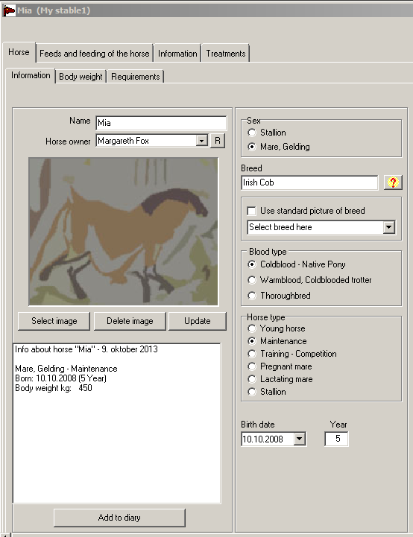
The Irish Cob Mia.
Sex: Mare
Age: 5 years
Body weight: 450 kg
Blood type: Cold blood –Native Pony
Horse type: Maintenance

Slide 12
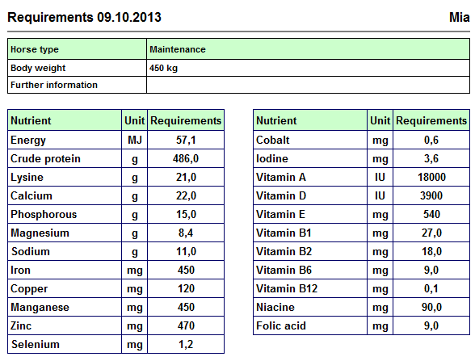
Below are the calculated requirements for Mia
When the requirements for the various nutrients have been calculated, it is our task to formulate a daily ration which will:
Provide the nutrrients required in a best possible way.
Satisfy the horse’s demands for fibre in the ration.

Slide 13
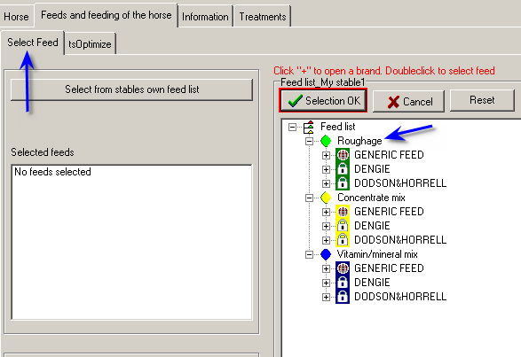
You are now going to select the feeds for Mia.
Always start with the roughage!

Slide 14
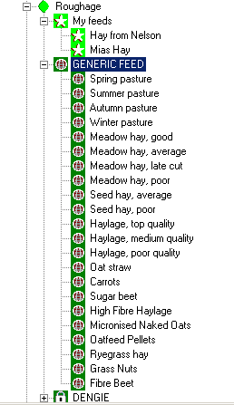
The list of roughages…
The roughage will come from the feed list of the stable where Mia is located:
You can select feeds you have analysed and entered yourself (shown with an asterix)
In addition you can choose from a list of standard (generic) feeds
Select one or several roughages and check out how well they cover the nutrients Mia needs.
You can experiment with roughages of different quality, and observe how the ration properties change.

Slide 15
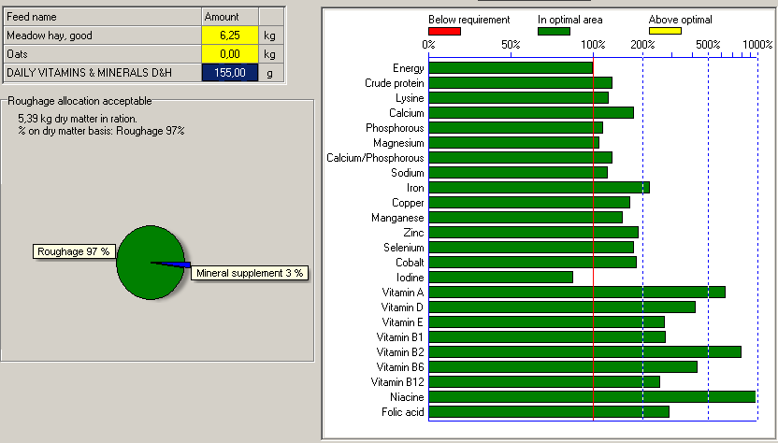
In this example we have selected a meadow hay of good quality.
6.25 kg hay will cover Mias energy demands.
This is equivalent to 1,2 kg of hay dry matter per 100 kg body weight for a hay with 87% dry matter.
No extra concentrate is required, but a vitamin- and mineral mix is needed to balance the ration.

Slide 16
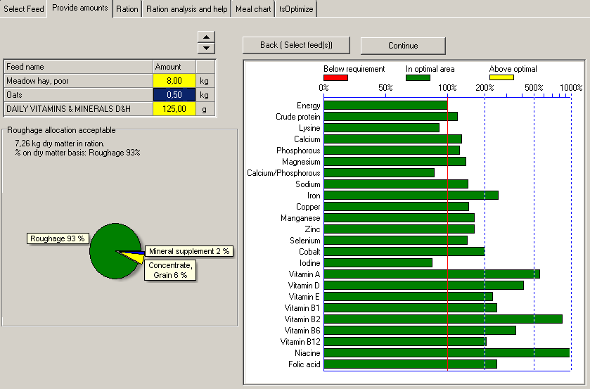
A late cut hay with lower feed valueis selected as the roughage.
This hay has a lower energy content than in the last example.
Even when giving 8 kg of this hay, we need to supplement the ration with a balancer to meet the energy demands,. The upper limit for roughage will first reached at about 14 kg.

Slide 17
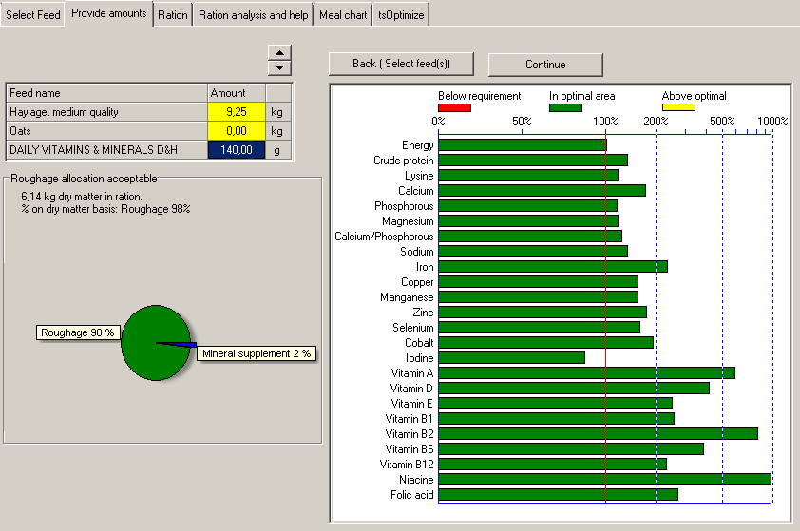
In this example we have selected Haylage from grass of medium quality with 70% dry matter
9.25 kg of haylage is required to cover the energy requirement,
This is because the 30% of the feed weight is water.
Mia gets 1.44 kg of roughage dry matter per 100 kg body weight, which is well above the 1 kg limit.

Slide 18
Putting weight on a horse with worn teeth and poor appetite
”Emma” has become a poor hay eater, and is now more or less unable to eat hay.
She used to weigh 550 kg, but has over the last 3 years lost 100 kg of her body weight. She takes a little exercise every day (training level 5%). Her energy requirement at her present body weight is 66 MJ/d.
If we can get her to eat to fill the energy requirement she would have when weighing 550 kg, she would eat 80 MJ/d.
To put on 1 kg body weight, 16 to 20 MJ of energy is needed,
depending on the proportion of roughage in the ration.
An intake of some 20 extra MJ/d of energy for 3-4 months will
be required to regain her previous body weight.
A challenging situation!

Slide 19
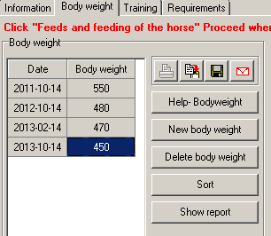
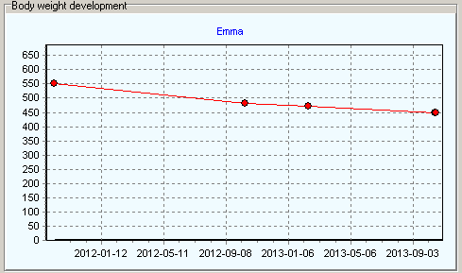
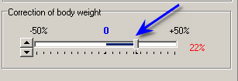
Emmas body weight has declined by 100 kg from her «ideal weight» of 550 kg
during the last 3 years
Use the slider to adjust energy without affecting other nutrient requirements

Slide 20
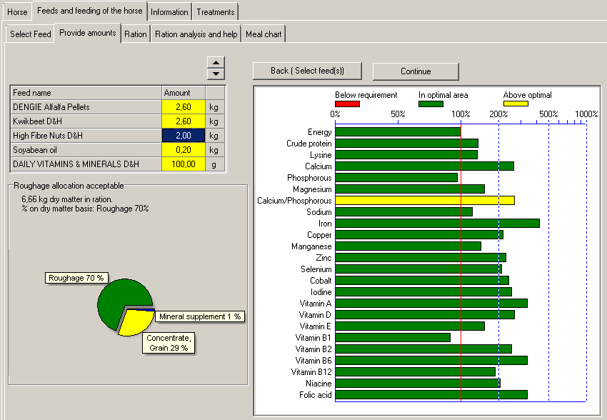
In this example we have selected «High Fibre nuts» to provide structure, «Kwik beet» and «Alfalfa» at a rate of 0,6kg/100 kg BW plus «High fibre nuts» and 2dl soybean oil. More soybean oil can be used safely to increase the energy desity. A vitamin/mineral mix is required.
Eating this ration, «Emma» should gain about 1 kg/d, and needs 100 to 150 days to put on the weight.

Slide 21
Create rations for your client’s horse as a "maintenance horse»
Weigh the horse on a scale, - or use PC-Horse to calculate the weight from the chest girth (chest circumference in cm).
Use their roughage. If you do not have a proper feed analysis, you should as a minimum make a simple estimate of the dry matter content if you feed haylage.
If the horse is active, you can define it as «In training»
How does the ration fit with the amounts of feed they give on a daily basis?

